Slide 1
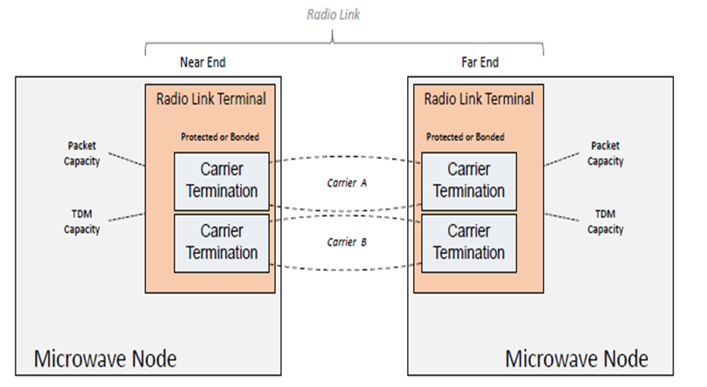





SDN Applications for microwave radio link
Purpose: To validate the model defined in draft-ietf-ccamp-mw-yang-01
What’s developed in hackathon:
MW YANG model in ODL controller
Two applications: Energy Efficiency and Dynamic frequency control
https://github.com/ietf-ccamp-mw/IETF-CCAMP-Microwave-YANG-Data-Model
App 1: Energy efficiency
to save power consumption when traffic is low
Day Time
App 1:
Energy efficiency
App 2:
Dynamic frequency control
Traffic
Night Time
Power consumption
Peak time
Off-peak time
With energy efficiency
MW YANG
model
SDN controller – ODL based
draft-ietf-ccamp-mw-yang
App 2: Dynamic frequency control
to control the interference
！
Low SNIR
SNIR
f1
Alert threshold
f2
Frequency
f1
f2

